Slide 1


Slide 2
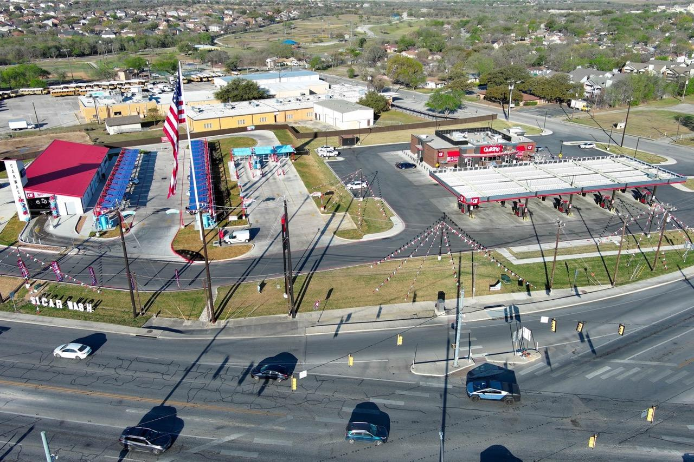
Bubble Bath Car Wash by QT

Slide 3
Agenda
Bubble Bath Car Wash
Traffic Congestion/Traffic Light
Current Memorial Drive Tenants
Water Study
Trash
DKPD Substation
QT Donation(s)

Slide 4
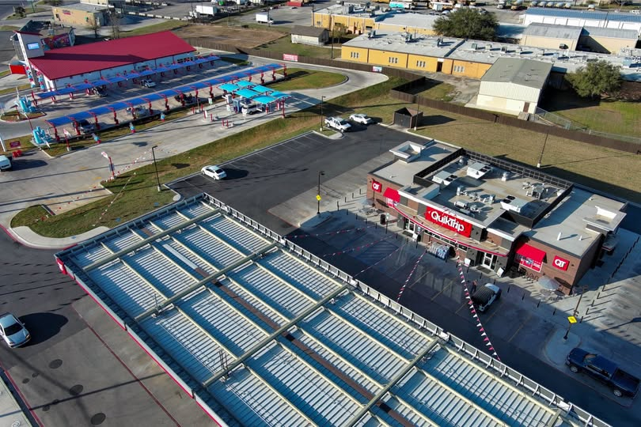
Bubble Bath Car Wash
Proposal – Very early stage
Expected – Within next 3 years
Dunaire Community Support
Current Tenants – Through 2027
Water Study – No current increase or impact to Dunaire

Slide 5
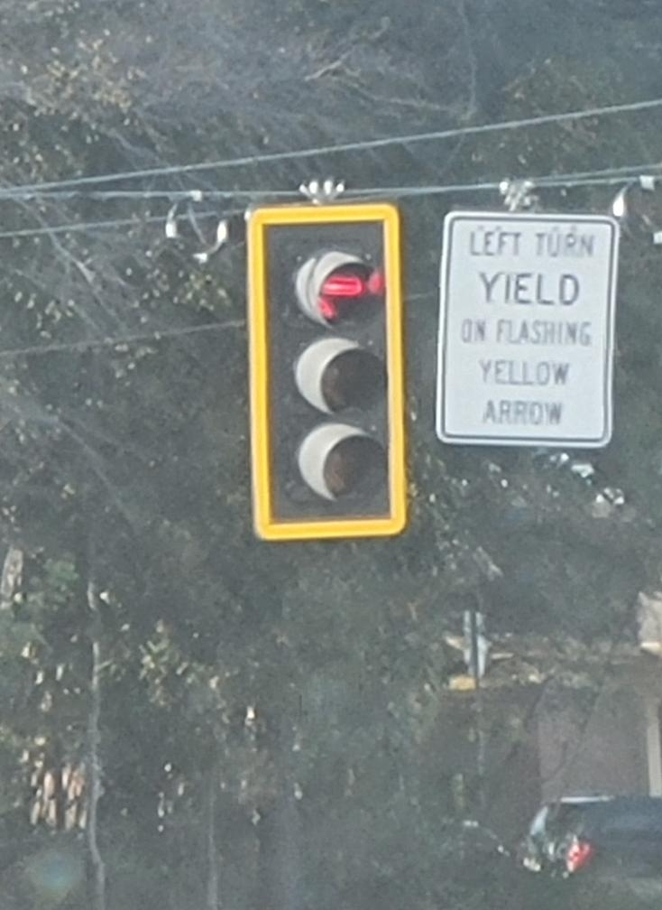
Traffic Congestion Traffic Light
Eric is working with the DeKalb County Traffic Management Center (TMC)
Traffic study confirms a need for a dedicated left turn signal at the Collingwood Drive and Memorial Drive intersection

Slide 6
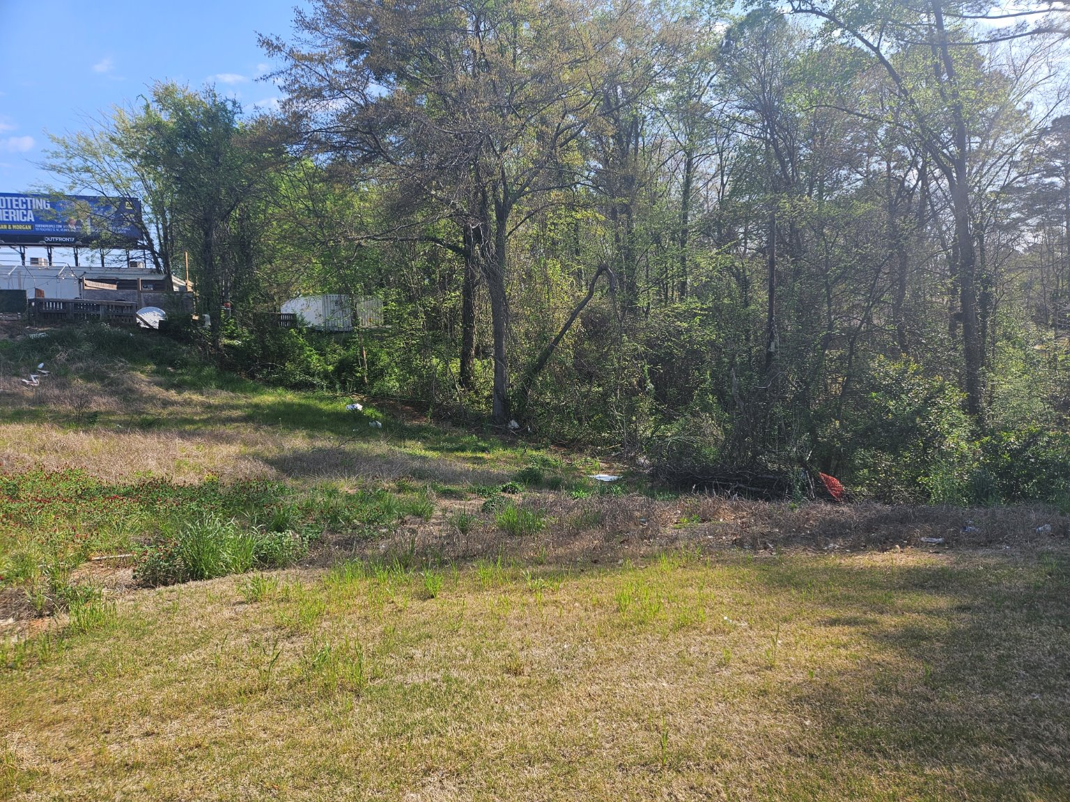
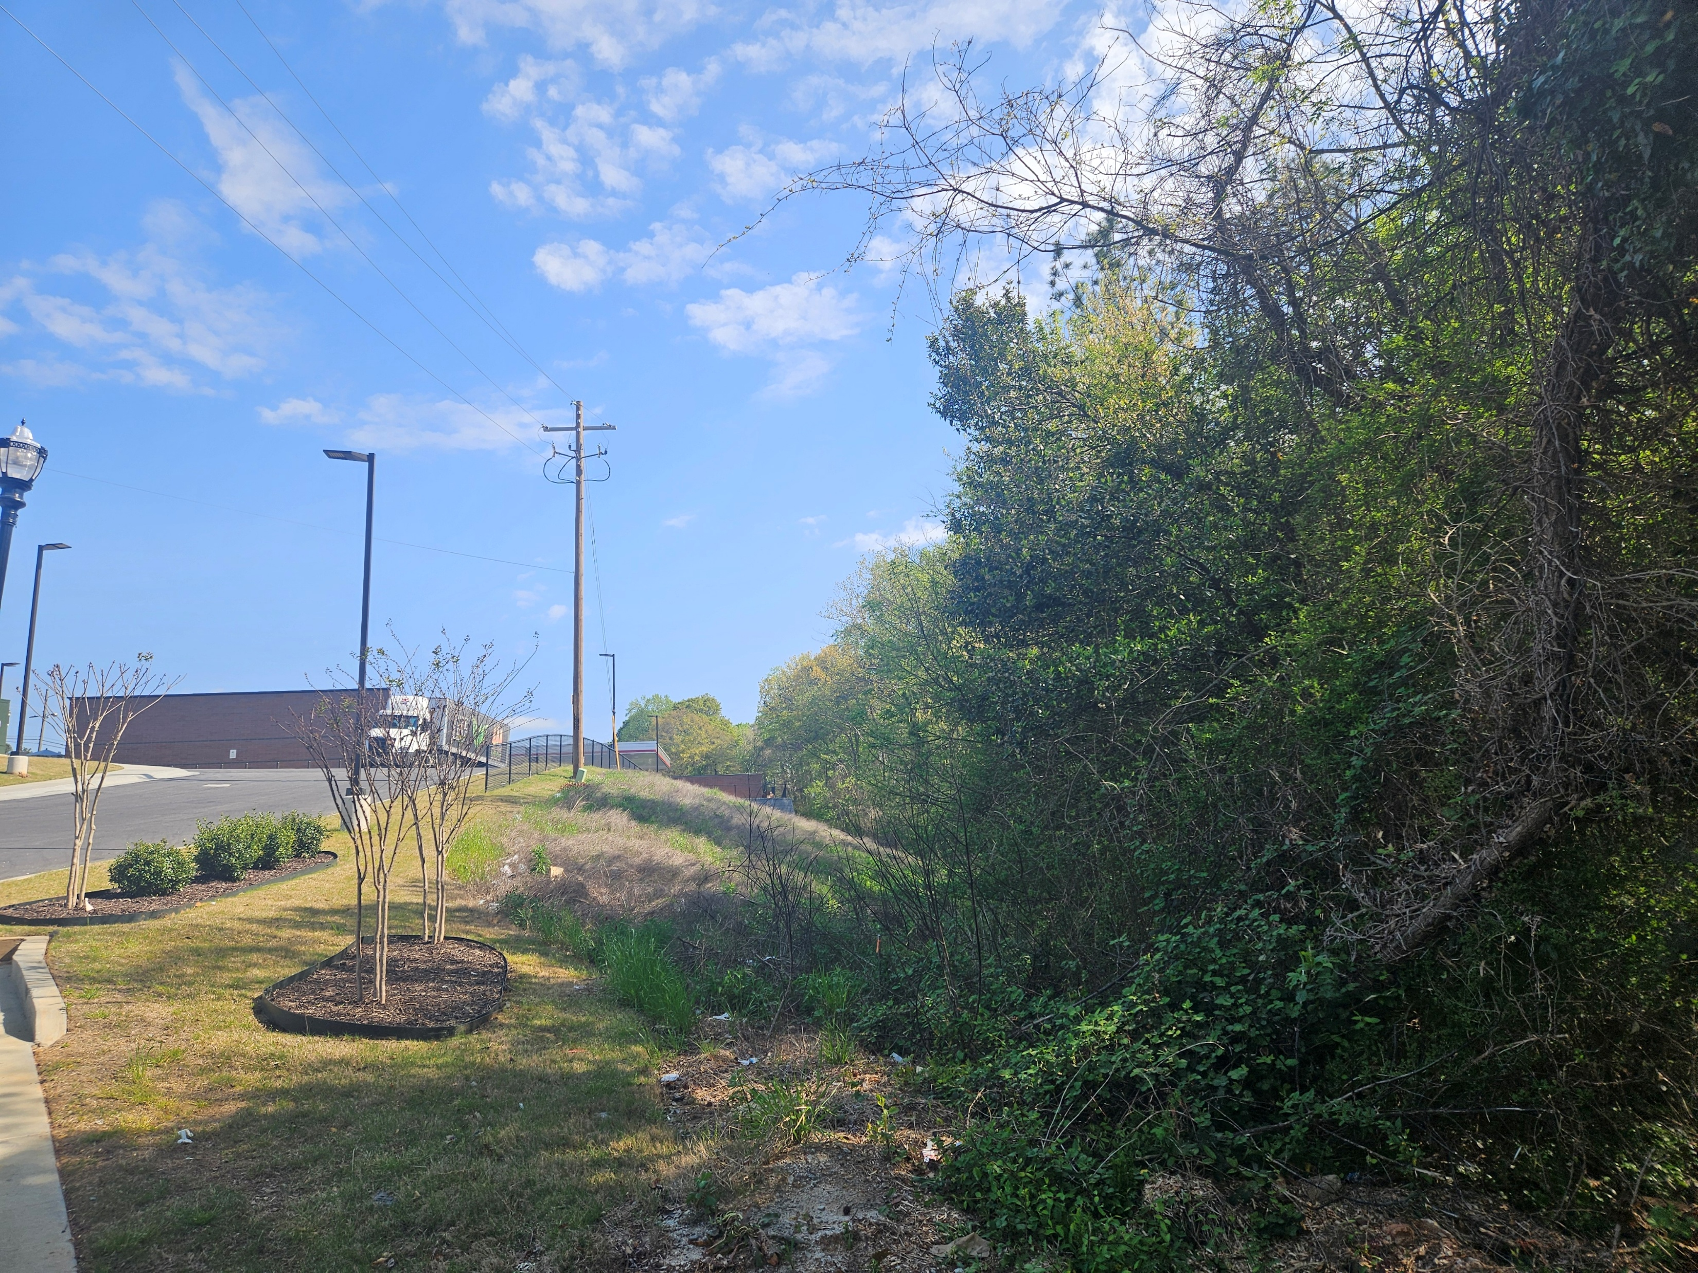
Trash
Included in the clean-up:
Trash from Collingwood Drive to back of current carwash and fenceline.
Possibly add homeless encampment (actually DeKalb County)
Downward to land markers
Still working with DK Sanitation to change schedule to near noon.
Eric to send crew within one week from date of meeting.

Slide 7
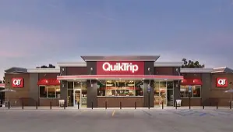
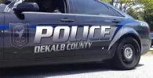
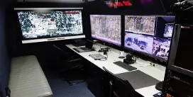
DeKalb County Police Substation
MEMORIAL DRIVE
COMMAND CENTER

Slide 8


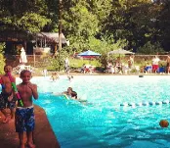
QT Donations
Proposals in writing to Eric
Additional Signage (Private Property at both entrances)
Pool – Itemized requests with dollar amount
Monetary Donation(s)
Additional Suggestions –
Please see Edee, Amahl or Will

Slide 9


Slide 10



